Slide 1
Architecture Design
v0.1

Slide 2
IoT Ecosystem
AI Chatbot System
3
IoT Cloud Core
Implementation
Control device through conversational API
Python
Java
Spring Cloud
Nosql
Spark
Hadoop
IoT Insight Service based on leading edge technologies
2
5
Data Ingestion &
Real-time Analysis
Knowledge & Graph Analytics
ML | DL
Graph Data & Knowledge Base
NLU
SKlearn
Keras
TensorFlow
Caffe
Yolo
Faster-RCNN
Algorithms
1
Machine | Deep Learning
Connection Protocol
IoT Edge
& Devices
Cloud Native
Predictive Maintenance
& Anomaly Detection
Docker
Kubernete
4

Slide 3

IoT enabled Applications
Realtime and historical API & UI
3
Message Hub (Kafka)
Authentication & Authorization
IoT Hub
IoT Analytics
External Datastore
2
4
8
Application
Rule
Engine
(anomaly detection,filter,processor,etc)
Advanced Analytics
(enrich,convers,merge,aggregate,etc)
Action Plugins
Event
MQTT
CoAP
Plugin
External Message Hub
API
API
1
HTTP
WebSocket
API
Device
Gateway & Edge Analytics Agent
Event
Event
3rd Party
Cloud Services
Device
Device
Event
Device
Device Registry
Metadata & Event Management
Device Shadow
5
6
7
Mongo
Cassandra
Schema
Rule
Action
API
Event &
State Cache
API
Virtual Data Point
Mongo
API
SDK
IoT Platform

Slide 4
Modular Edge Architecture
Message Hub & Local Data Store (Kafka)
Local Device Shadow
Local Metadata & Event Management
Local IoT Analytics
Rule based Message Filter
Engine
Republish MQTT Action Workload
Local Openwisk
Workload
Openwisk
Container
API
Event &
State Cache
Kafka
Cassandra
API
API
Module Container
Module Container
Module Container
Module Container
Module Container
Module Container
Custom Container
File Adapter
HTTP Adapter
MQTT Adapter
CoAP Adapter
OPC
Adapter
AWS-IoT
Adapter
XXX
Adapter
File Configuration
HTTP Configuration
MQTT Configuration
CoAP Configuration
OPC Configuration
AWS-IoT
Configuration
XXX
Configuration

Slide 5
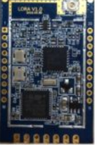
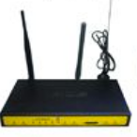


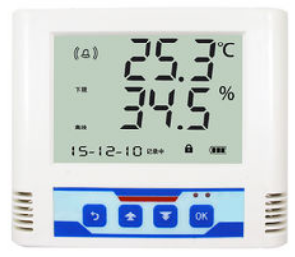
端
管
云
电表
UART
LoRa WAN Node
烟雾
UART
LoRa WAN Node
水表
UART
LoRa WAN Node
LoRa数据包转发
温湿度
UART
LoRa WAN Node
LoRa
网关桥
json/mqtt
PM2.5
UART
LoRa WAN Node
LoRa网关
IoT云平台
燃气表
上行数据（采集）
UART
LoRa WAN Node
下行指令（控制）
空调
UART
LoRa WAN Node
采集 + 控制

Slide 6
Device Shadow
shadow/update/documents
shadow/get/accepted
Get success
shadow/update/accepted
shadow/get
Update success
shadow/get/rejected
shadow/update
Get failure
shadow/update/rejected
Update failure
Delete success
shadow/delete/accepted
report state is different with desired state
shadow/update/delta
shadow/delete
shadow/delete/rejected
Delete failure

Slide 7
Conversation System
Speech Recognition
Natural Language Understanding
Dialog Engine
NLU Engine
Dialog Engine
Voice
Intent
Entity
Reference
Engine
Response Action
STT
TTS
今天天气如何？
State Management
Inbound/Outbound API
Training
Training
Text
Model Management
今天天气不错....
Model
Training Data
Pipeline Config
External System

Slide 9
IoT Ecosystem
AI Chatbot System
IoT Cloud Platform
Control device
through API
Data Ingestion
Connection Protocol
IoT Edge
& Devices
Model Manager
(Persist, Scheduler)
Model Training
(Learning)
Model Scoring
Predictive Maintenance
& Anomaly Detection

Slide 10
IoT for Waste Management

Slide 11
Conversation System powered by Machine | Deep Learning
a machine | deep learning, conversational dialog engine for creating chat bots

Slide 12
Conversation System
Speech Recognition
Natural Language Understanding
Dialog Engine
NLU Engine
Dialog Engine
Voice
Intent
Entity
Reference
Engine
Response Action
STT
TTS
今天天气如何？
State Management
Inbound/Outbound API
Training
Training
Text
Model Management
今天天气不错....
Model
Training Data
Pipeline Config
External System

Slide 13
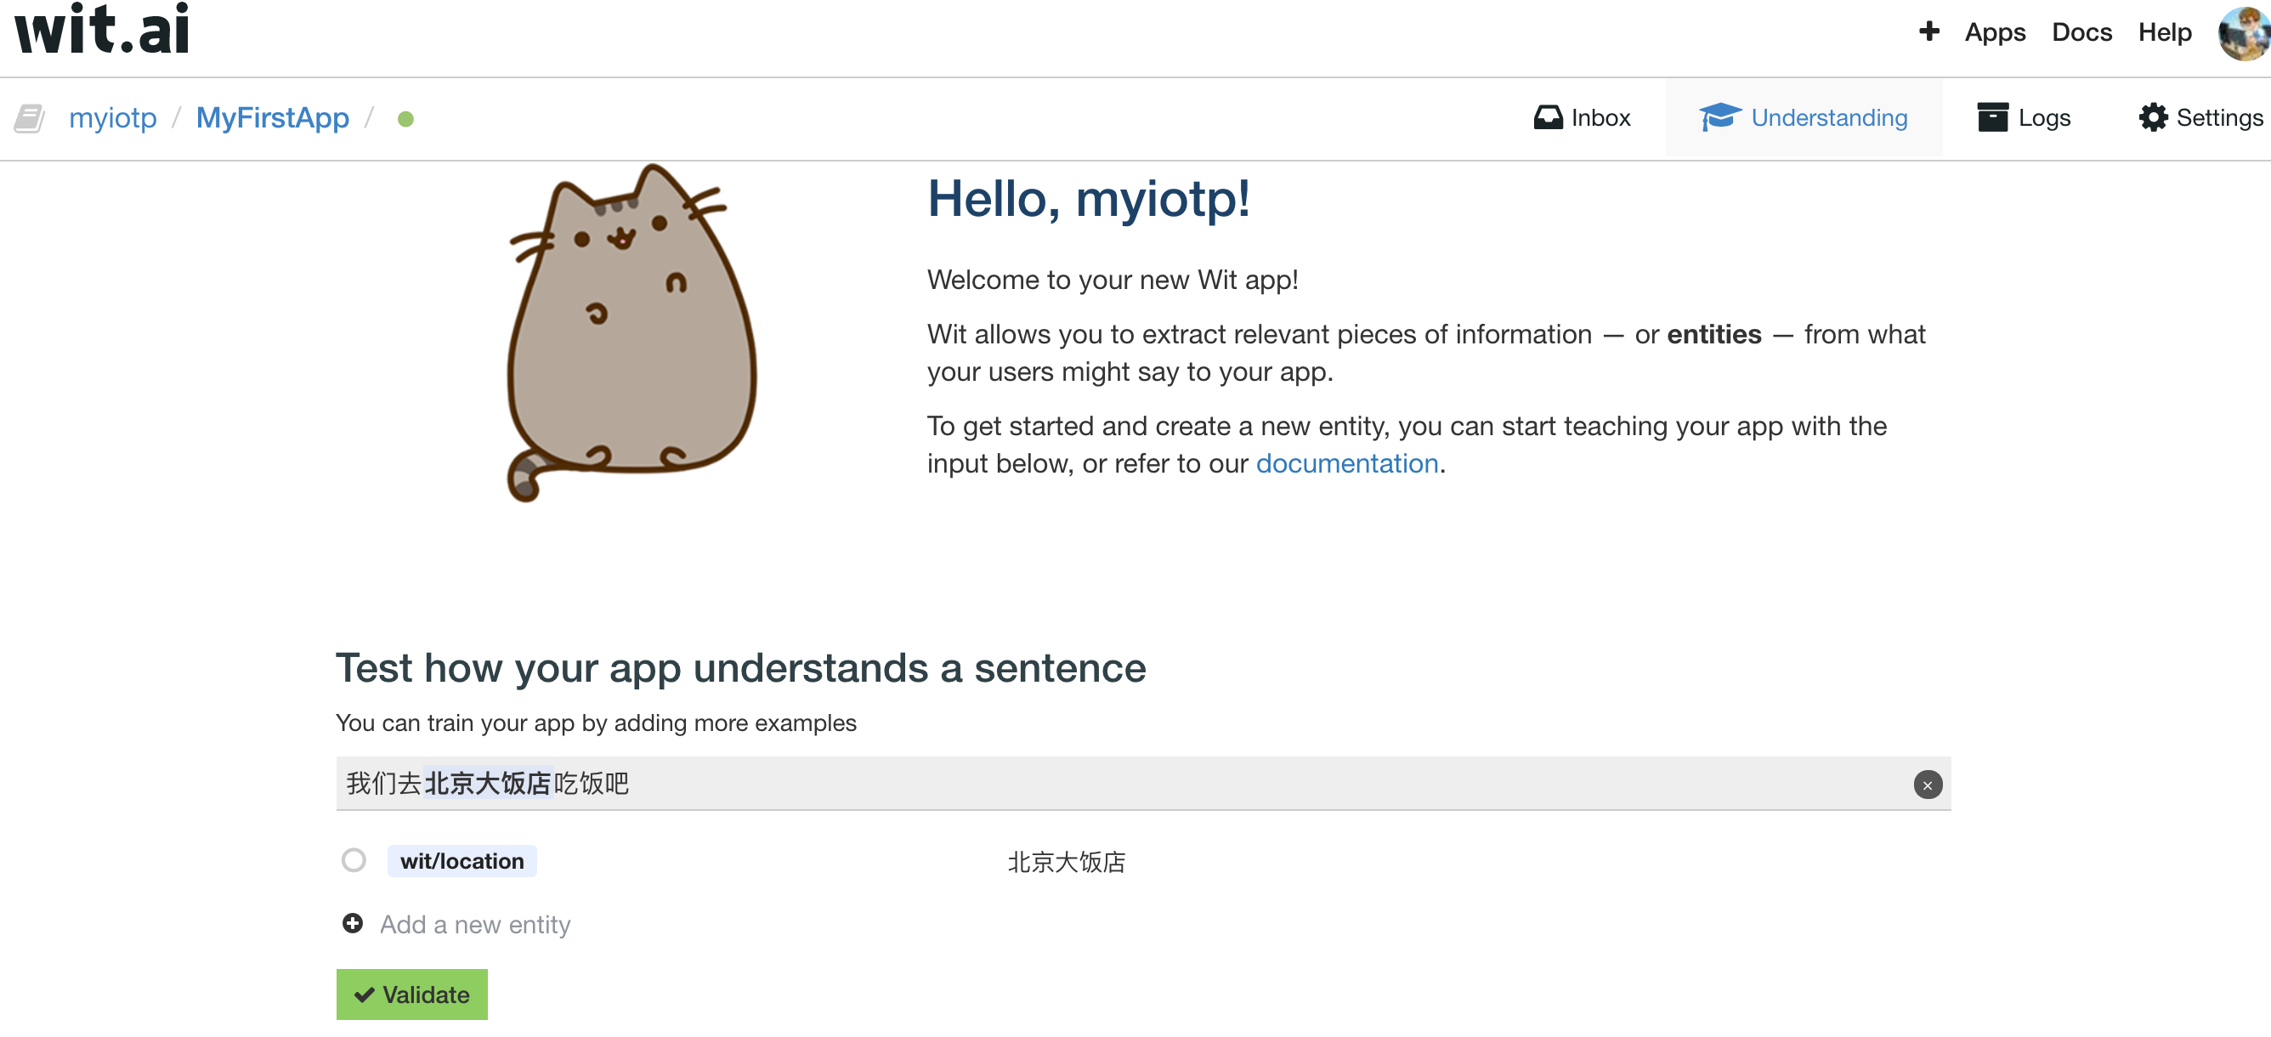
Reference

Slide 14
Competitors | Advantage | Disadvantages
API.ai | Smarter and can learn alternative phrases which can trigger intents and understand alternative entities. Allows you to manage context parameters through the UI. Easily add entities by highlighting them in the sample utterances through the UI. Allows you to mark entities/parameters as required so the platform manages retrieving the entity/parameter values from the user without having to go to your business logic. Alexa requires you to manage this yourself in the business logic code. Rich set of domains for building chat bots with out of the box functionality (small talk, weather, flight, news, etc.). | Lack of diagnostic tools to measure the true positives, true negatives, false positives and false negatives related to intent and entity matching. Microsoft LUIS provides detailed metrics on how your intents and entities are being resolved. Lack of visualization of conversation flows. Wit.ai has a nice “Stories” feature which allows you to visually represent the conversation flows, business logic invocations, context variables, and branching logic.
Wit.ai | Easier to develop applications using the developer UI. Smarter and can learn alternative phrases which can trigger intents and alternative entities. Allows you to manage context parameters through the UI. Easily add entities by highlighting them in the sample utterances through the UI. Visually see and edit the conversation flow tree. Wit.ai also supports the idea of roles for entities. When you say "from LA to New York" both LA and New York are location entities but you can further distinguish between a fromLocation (LA) and toLocation (New York). The only other framework to support this feature is LUIS (with hierarchical entities). | Does NOT have the required slot/parameter feature so you have to invoke business logic after every interaction which gathers slot/parameter information from the user to gather any missing information which was not spoken by the user. Limited predefined reusable domains of global skills. Some diagnostics but very limited in comparison to MS LUIS. Webhook integration is unclear. All of the documented examples only invoke logic in interactive mode locally or only work with Facebook messenger apps. Although, you can specify context variables for missing required parameters, you have to manage the retrieval of missing required parameters by using "Bot Executes" logic, context variables, and jumps. Both API.ai and LUIS handle the prompting for missing required parameters by just configuring them as "required" in their development UI.

Slide 15
Competitors | Advantage | Disadvantages
Alexa | Alexa is pretty straight forward to program and develop AI assistant applications with. Applications can run on any platform. You have full control because you have to manage all of the interactions in code (context, session, required parameters, etc.) Intent Chaining An intent performs an action in response to natural language user input. Amazon Lex can transfer control dynamically from one intent to another based on end user input. This enables you to simplify complex conversations by breaking them into smaller components. For example, in a travel bot, after a user has booked a flight, you can build your bot to subsequently ask if the user also wants to make a hotel or a car reservation. The user response could then result in either making additional reservations, or decline any additional bookings. Amazon Lex will handle the flow accordingly. Utility Prompts Amazon Lex provides two types of prompts: confirmation prompts that enable you to confirm an action before fulfilling it; and error-handling prompts, that request the user to repeat input for additional clarity. Confirmation prompts allow you to confirm the intent of the user before executing back-end business logic (for example, "Would you like to confirm your reservation now?"). Error-handling prompts address scenarios where the user input is not understood, allowing for a graceful handling of error scenarios. For example, if a user’s speech input is not clear or audible, or doesn’t map to a known intent, you can configure Amazon Lex to prompt the user to repeat information, for example, “Sorry I didn’t get that.” or “Can you please repeat that?”. You can set the number of retries and also specify the goodbye message before your app stops prompting the user. | Every triggered intent requires a webhook call. No development UI—you have to input your intent schema, utterances, slots and manage all of the relationships manually. Relatively weak in terms of machine learning. Harder to develop with in comparison to API.ai and Wit.ai. Limited diagnostic tools. Have to input exact phrases which trigger intents. Limited predefined reusable domains of global skills. You have to manage the retrieval of missing required parameters in your business logic. Both API.ai and LUIS provide automated prompting for missing required parameters once configured in their development UI.
MS LUIS (Language Understanding Intelligent Service)/Cortana | Smarter and can learn alternative phrases which can trigger intents and alternative entities. Easily add entities by highlighting then in the sample utterances through the UI. Allows you to mark entities/parameters as required so the platform manages retrieving the entity/parameter values from the user without having to go to your business logic. LUIS provides richer metrics to understand how well your AI assistant app is working. LUIS also supports something called composite entities. Think of composite entities as a grouping of entities into a single predefined entity. For example, in "2 adult first classtickets from LA to NY"--2 is the number of tickets, adult is the ticket type, and first is the ticket class but all of the entities together constitute a ticket order composite entity. None of the other AI frameworks support composite entities. | Does not allow you to manage context parameters through the UI or filter intents based on context parameters set in previous intents as API.ai does. You have to manage these yourself similar to Alexa. Does not include a rich set of domains for building chat bots like API.ai. Building apps with Cortana and LUIS requires you to build UWP (Universal Windows Platform) apps (ultimately tying you to the windows platform).

Slide 16
Machine Learning based NLU
Authentication & Authorization
Conversation Insights UI (nodejs)
NLU Training and Parsing Pipeline
NLP_MITIE
Tokenizer_Jieba
NER_MITIE
NER_SYNONYMS
SystemCorpus
Custom Corpus
SystemDict
Custom Dict
tokens
entity annotations
Synonym
Mapper
Featurizer_Regex
Featurizer_MITIE
Classifier_Sklearn
Custom Plugin
for Specific Processing, e.g. Time(Duckling)
Pattern
Regex Engine
tokens
entity annotations
tokens
entity annotations

Slide 17
MITIE/tools/wordrep
wordrep -e a_folder_containing_only_text_files
1
NLP_MITIE
name = "nlp_mitie"
provides = ["mitie_feature_extractor"]
SystemCorpus
Custom Corpus
Tokenizer_Jieba
provides = ["tokens"]
name = "tokenizer_jieba"
SystemDict
Custom Dict
name = "ner_mitie"
NER_MITIE
provides = ["entities"]
requires = ["tokens"]
tokens
entity annotations
trained model
NER Model

Slide 18
NER_SYNONYMS
trained model
2
name = "ner_synonyms"
Synonym
Mapper
provides = ["entities"]
NER Model
Featurizer_Regex
provides = ["text_features"]
name = "intent_entity_featurizer_regex"
Pattern
Regex Engine
For example, for each patterns, return 1 if matched,
otherwise, return 0;
The returned vector: [1,0,1,1,0,0]
requires = ["tokens"]
name = "intent_featurizer_mitie"
Featurizer_MITIE
provides = ["text_features"]
requires = ["tokens"]
For example, for each extracted token,
get_feature_vector based on feature_extractor
tokens
entity annotations
requires = ["mitie_feature_extractor"]
name = "intent_classifier_sklearn"
Classifier_Sklearn
provides = ["intent", "intent_ranking"]
requires = ["text_features"]
trained model
tokens
entity annotations
Intent

Slide 19
Natural Language Processing Toolkit
Name | Description
MIT Information Extraction Toolkit | C, C++, and Python tools for named entity recognition and relation extraction; MIT License
spaCy | Industrial strength NLP with Python and Cython.
Stanford NLP | written in Java. Licensed under the GNU General Public License (v3 or later for Stanford CoreNLP; v2 or later for the other releases).
jieba | Chinese Words Segmentation Utilities.
SnowNLP | A library for processing Chinese text.
Natural Language Toolkit (NLTK) | Written by the creators of NLTK, provides a practical introduction to programming for language processing.
TextBlob | Providing a consistent API for diving into common natural language processing (NLP) tasks. Stands on the giant shoulders of NLTK and Pattern, and plays nicely with both.

Slide 20
Performance

Slide 21
Sklearn Classification

Slide 22
Linear dialogs
the aim of which is to collect the information necessary to complete the required action (e.g. find the best hotel, turn on the right light bulb, or play the desired song)
To build linear dialogs, we use a feature known as slot filling.

Slide 23
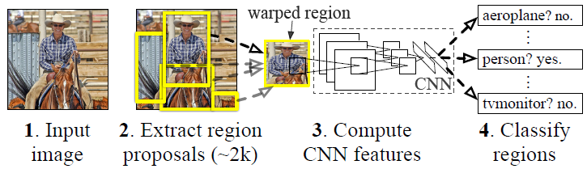
RCNN
RCNN算法分为4个步骤 - 一张图像生成1K~2K个候选区域 - 对每个候选区域，使用深度网络提取特征 - 特征送入每一类的SVM 分类器，判别是否属于该类 - 使用回归器精细修正候选框位置

Slide 24
Backup

Slide 25
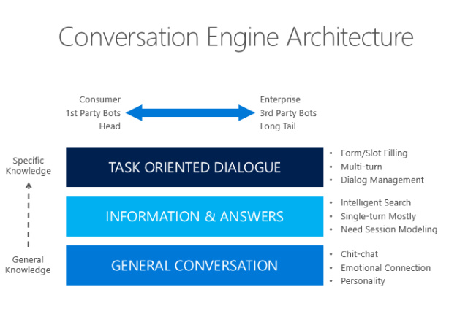
人机对话的三个层次

Slide 26
ChatterBot
ChatterBot是一个基于机器学习的聊天机器人引擎,构建在python上,可以从已有的对话中学习, 该项目的设计允许它接入任何语言
特性
一个未经训练的ChatterBot机器人,并没有与用户交谈所需的知识。
每当用户输入一句话，机器人将存下它，同时也存下答复的句子。
随着机器人接受的输入的增加，它能够回答的问题的数量和准确度都会相应提升.
实现原理
首先从已知句子中匹配出与用户输入最相近的句子（如何衡量相近, 大家可以想想）,
之后找到最有可能的回复，那么如何得出最有可能的回复呢？由所有和机器交流过的人们，对这个输入问题（匹配过的）的各个回答的频率决定

Slide 27
Setup Environment
Python3
By default, python3.5.2 is installed in Ubuntu 16.04
sudo apt-get install -y python3-pip
pip3 install package_name
Installing ChatterBot from source
git clone https://github.com/gunthercox/ChatterBot.git
pip3 install ./ChatterBot
Checking the version of ChatterBot that you have installed
python3 -m chatterbot --version

Slide 28
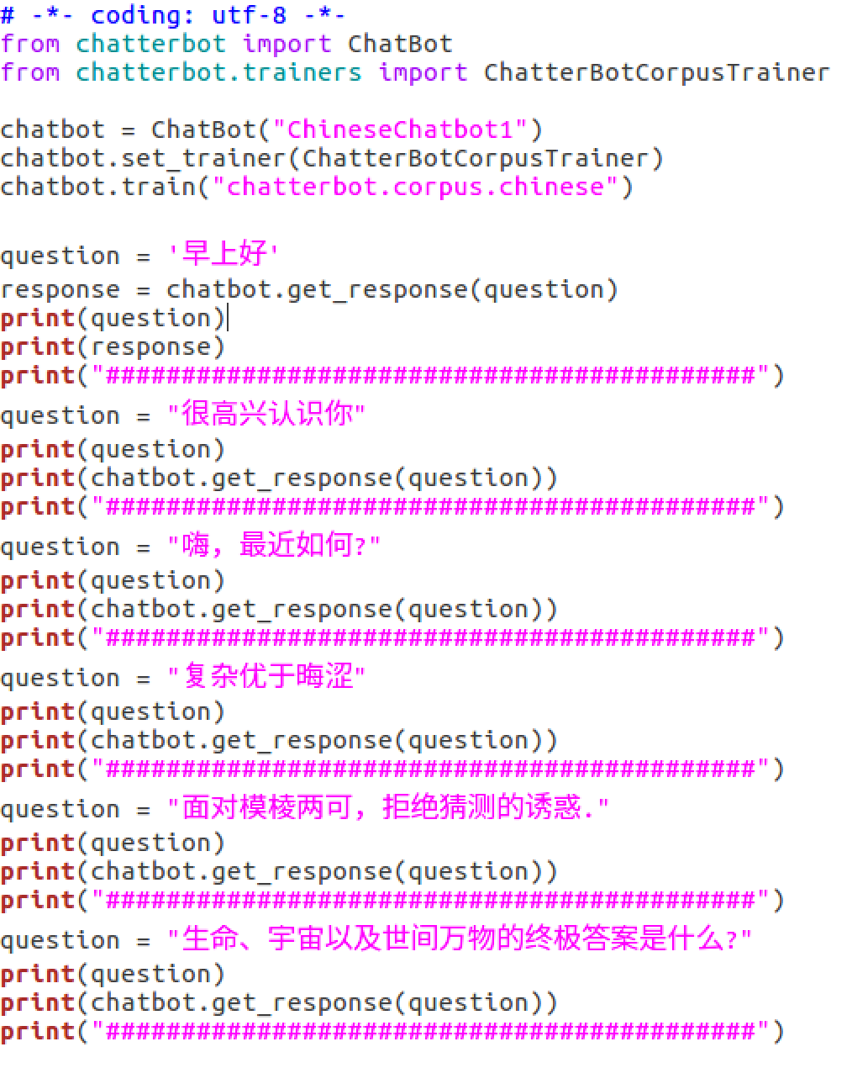
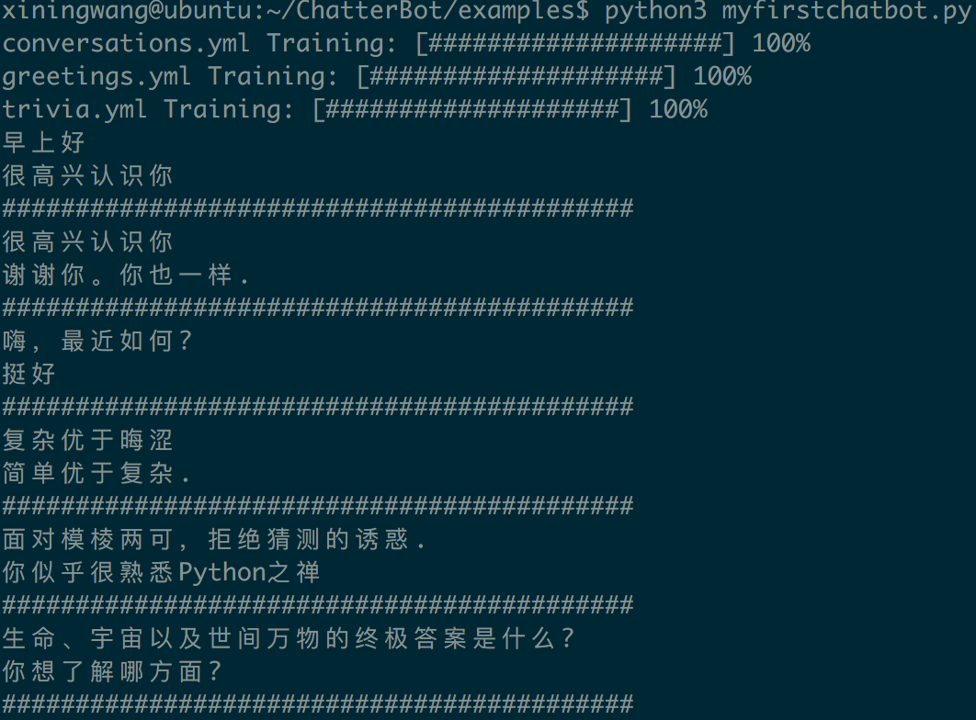
First Try

Slide 29
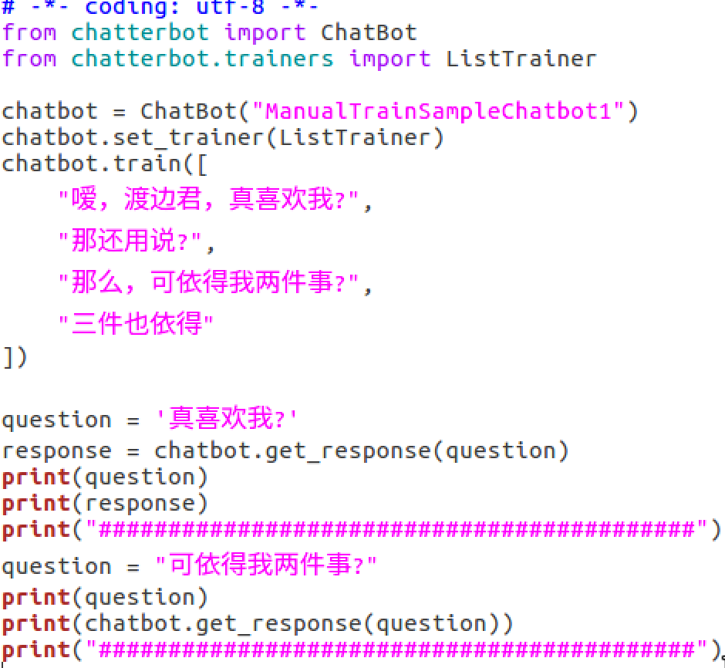
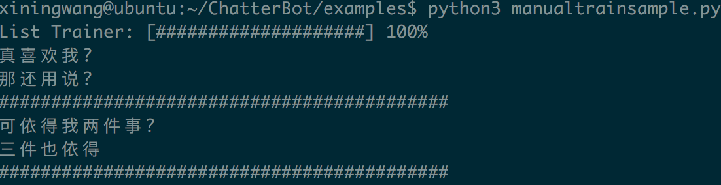
手动训练

Slide 30
算法相关
默认情况下，使用 ClosestMatchAdapter 作为 logic adapter ，用来找出与用户输入最接近的一句话
核心代码为：
from fuzzywuzzy import process
closest_match, confidence = process.extract( input_statement.text, text_of_all_statements, limit=1 )[0]
fuzzywuzzy用于计算句子之间的相似度，采用的字符串相似度算法为 Levenshtein Distance(编辑距离算法)

Slide 31
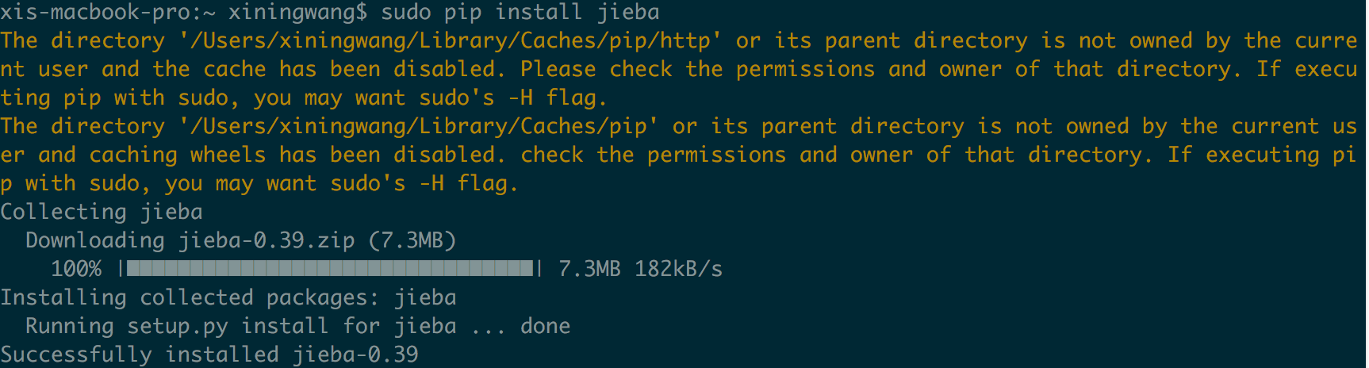
分词jieba
mac里面python自带easy_install的，最快的应该就是在terminal里面sudo easy_install pip了，网络好几秒就ok。运行完可以用pip help测试一下是否安装成功。

Slide 32
Set-up
$ git clone https://github.com/crownpku/rasa_nlu_chi.git
$ cd rasa_nlu_chi
$ sudo pip install -r requirements.txt
see next slide
$ sudo pip install -e .
$ sudo python setup.py install
If default python-dateutil version (1.5) is not compatible,
sudo easy_install python-dateutil==2.1

Slide 33
# Minimum Instal Requirements
-r requirements_bare.txt
# Spacy Requirements
-r requirements_spacy_sklearn.txt
# MITIE Requirements
-r requirements_mitie.txt
duckling==1.7.2
sudo easy_install matplotlib==1.5.3

Slide 34
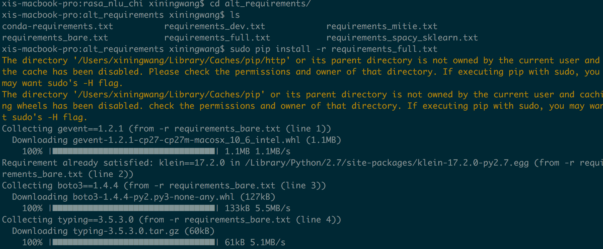
dependency resolution

Slide 35
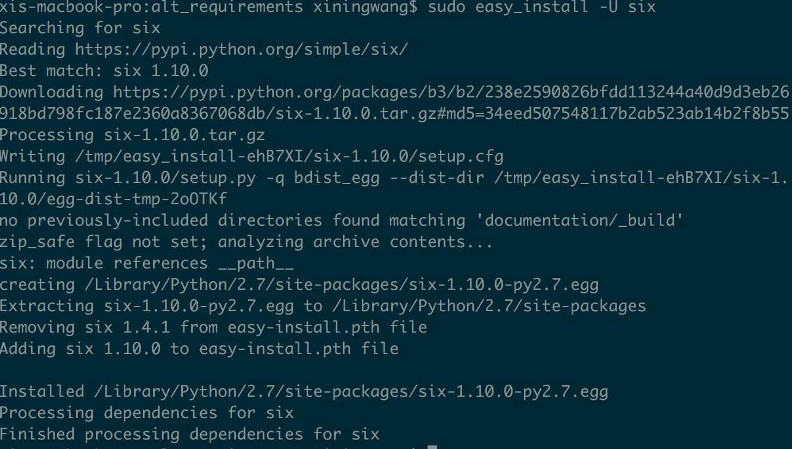
dependency issue: six, numpy
numpy==1.12.1
sudo easy_install numpy==1.12.1

Slide 36
gfortran for scipy
https://gcc.gnu.org/wiki/GFortranBinaries#MacOS

Slide 37
UI
postgre docker image
https://hub.docker.com/_/postgres/
docker pull postgres
start a postgres instance
docker run --name mypostgres -p 5432:5432 -e POSTGRES_PASSWORD=passw0rd -d postgres
EXPOSE 5432 (the postgres port)
POSTGRES_PASSWORD: superuser password for PostgreSQL
POSTGRES_USER: If it is not specified, then the default user of postgres will be used.
PGDATA: The default is /var/lib/postgresql/data.
pgAdmin
https://www.pgadmin.org/

Slide 38
Architecture

Slide 39
Visualization of story training data
brew install graphviz
/usr/local/Cellar/graphviz/2.40.1/include/graphviz
pip install pygraphviz --install-option="--include-path=/usr/include/graphviz" --install-option="--library-path=/usr/lib/graphviz/"
python -m rasa_dm.visualize -d examples/concerts/data/stories.md -o graph.png
Note
If you have the errors: pygraphviz ValueError: Program dot not found in path
You need to add the directory with graphviz binaries to PATH.

Slide 40
Training your bot
1. Train NLU model
10~ seconds
2. Train Dialogue Policy
2~ minutes
python train_dm.py
3. Using your bot
python run.py

Slide 41
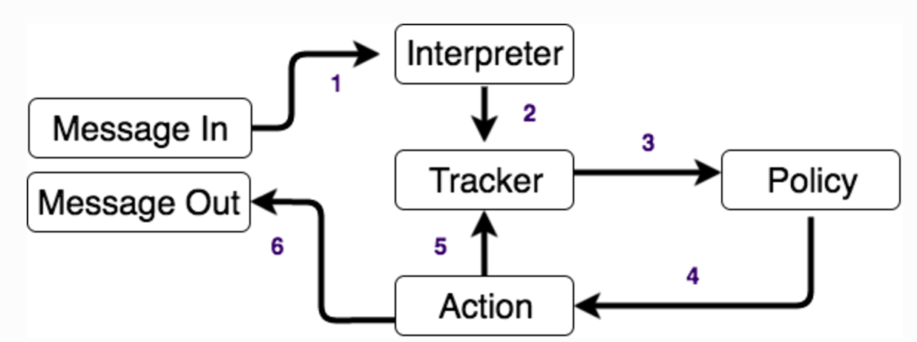
Logic Architecture
The message is received and passed to an Interpreter, which converts it into a dictionary including the original text, the intent, and any entities that were found.
The Tracker is the object which keeps track of conversation state. It receives the info that a new message has come in.
The policy receives the current state of the tracker
The policy chooses which action to take next.
The chosen action is logged by the tracker
A response is sent to the user

Slide 42
Achieve this generalisation by creating a policy based on Machine Learning

Slide 43
FAQ
SyntaxError: Non-ASCII character '\xe8' in file /Users/xiningwang/MachineLearning/rasa_dm/examples/restaurant_example.py on line 21, but no encoding declared; see http://python.org/dev/peps/pep-0263/ for details
putting # -*- coding: utf-8 -*- at the top of your .py file.

Slide 45
On-device processing

Slide 46
CORE FEATURES
Device Manager
The device manager allows individual devices to be configured and managed securely in a coarse-grained way; management can be done through a console or programmatically. The device manager establishes the identity of a device, and provides the mechanism for authenticating a device when connecting. It also maintains a logical configuration of each device and can be used to remotely control the device from the cloud.
Protocol Bridge
The protocol bridge provides connection endpoints for protocols with automatic load balancing for all device connections. The protocol bridge has native support for secure connection over industry standard protocols such as MQTT, HTTP. The protocol bridge publishes all device telemetry to Cloud Pub/Sub, which can then be consumed by downstream analytic systems.

Slide 47
IoT End to End System

Slide 48
IoT data abstraction

Slide 49
IoT platform : data abstraction layers

Slide 50
Capturing an IoT System with a graph data base

Slide 51
Capturing IoT data as a graph

Slide 53
IoT Chatbot http://radiostud.io/facilities-management-iot-chatbot-azure-iot/
Managing thousands of IoT devices via a dashboard may not always be the most intuitive way. After all, who wants to scan through the clutter of a thousand different things and their notifications. In this blog post, we show you a unique approach to solve this problem through an IoT chatbot. Just like you chat with your co-workers, you can also chat with your devices, and they can respond back too.
Read on to know how a facilities management team interacts with the device/assets via a chat interface to make their maintenance chores easier and seamless. This chat interface is powered by the Azure IoT Hub and PubNub.

Slide 54
Facilities Management with IoT Chatbot

